Slide 2





















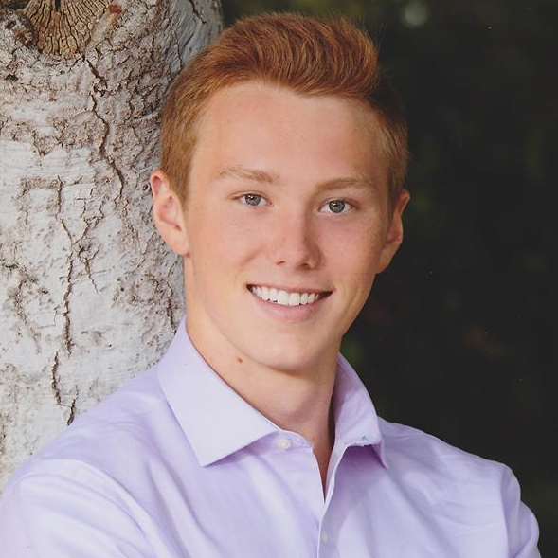







Slide 3
Patrick Famaran
Developer / Designer

Slide 4


Administratively
Payroll / Benefits / Perks
Socially
Managers / Peers / Support
Technically
Coding / Designing / Producing
Patrick Famaran
Developer / Designer
$$$

Slide 5
$37 Billion
Spent annually to keep unproductive employees who lack appropriate training
(UK + US)
The Business Case for Investing in Onboarding Programs. (2017, August 10), Paycor

Slide 6







Training Woes
Self
Serve
Active Learning
Literature
Studying for work
High time commitment, high time to productivity
Risk of retraining
THE
CONCEPT
Standardized Process
Continuous
Analytics
One-on-one
Varying Results

Slide 7

AR Vis tool

Slide 8
3 Step Process
Feedback given to client
Percentage of time per element
End-of-session survey
End-User Views Structure
AR Headset
Interactive Elements
Client defines structure
Simple JSON
Web Configuration

Slide 9
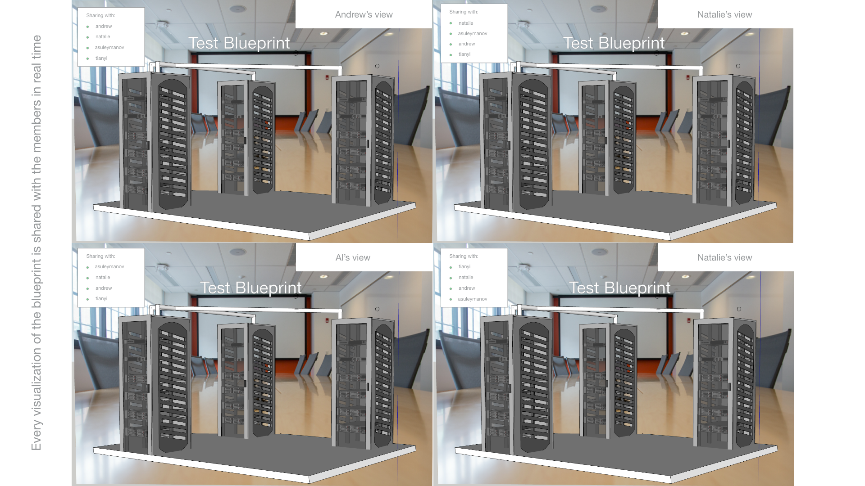

Slide 10



Training Hopes
Experience Learning
Per client registration fee
Per-user monthly subscription
Optional premium support fee
THE
CONCEPT
Short
Time-to-Productivity
Confident Results

Slide 11

2200
NEW HIRES
RBC Insider

Slide 12
$4000 Per Employee
Onboarding cost per employee
The Hidden Cost of Employee Onboarding (2016, September 7), Glassdoor

Slide 13





Flexible
Technically Focussed

Slide 14



Go-to Market
Paid Pilots
Engage potential clients with limited size pilots for potential discounts.
HR Trade Shows
Leverage current market attention on AR/VR to demonstrate utility of Blue Realm
Account Based Sales
Direct salespeople to pursue a target number of high value accounts
Development Purchase
Purchase test and demo VR equipment, suitable development machines and software licenses.
Key Hires
Hire experienced professionals in the HR space as well as those with experience in enterprise sales
Target Pilots
Two paid pilots within the second quarter, four by the third quarter

Slide 15
Future of
TO-DO

Slide 16
Work From Day One

Slide 17



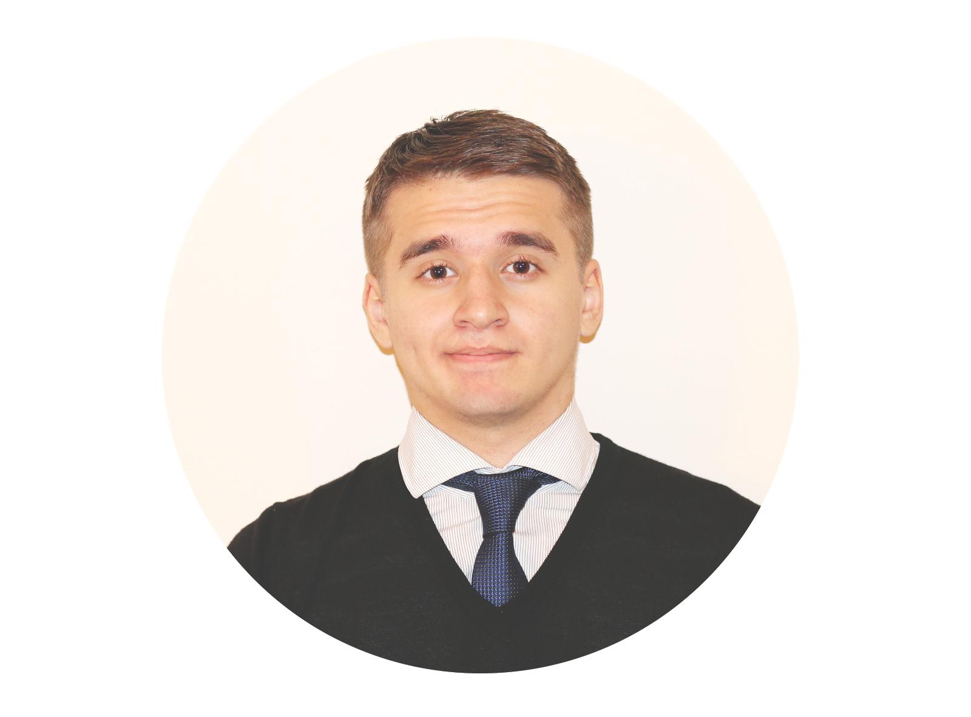
Thank you for your time
We welcome any questions

